Slide 1
Renewal Journey Guidance
How to guide for renewing your membership

Slide 2
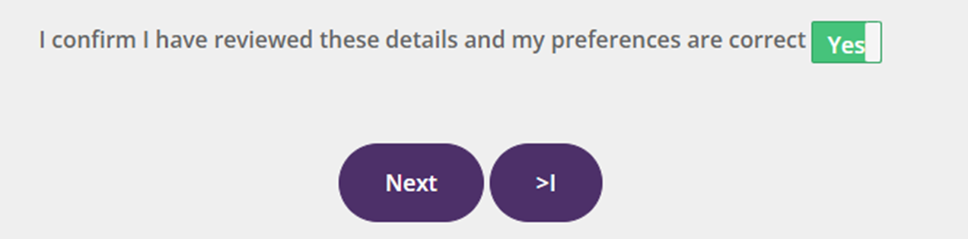

Payment options
There are a variety of payment options available to you. Our online portal now allows you to update your details, apply for a concession, select your Lionheart preference and select your preferred payment method.
To access the portal, use the link below or simply log in to your RICS online account and select Professional Fees from the menu on the left-hand side of the page.
https://myaccount.rics.org/ProfessionalFees
The online service allows you to pay 24 hours a day, seven days a week. Further details of different payment options can be found on the professional fees tab of our website www.rics.org/professionalrenewals
The line below is on every page of the portal. It’s highly recommended that you review your details and ensure your preferences are correct, proceed by selecting YES in the toggle bar at the bottom of each page.

Slide 3
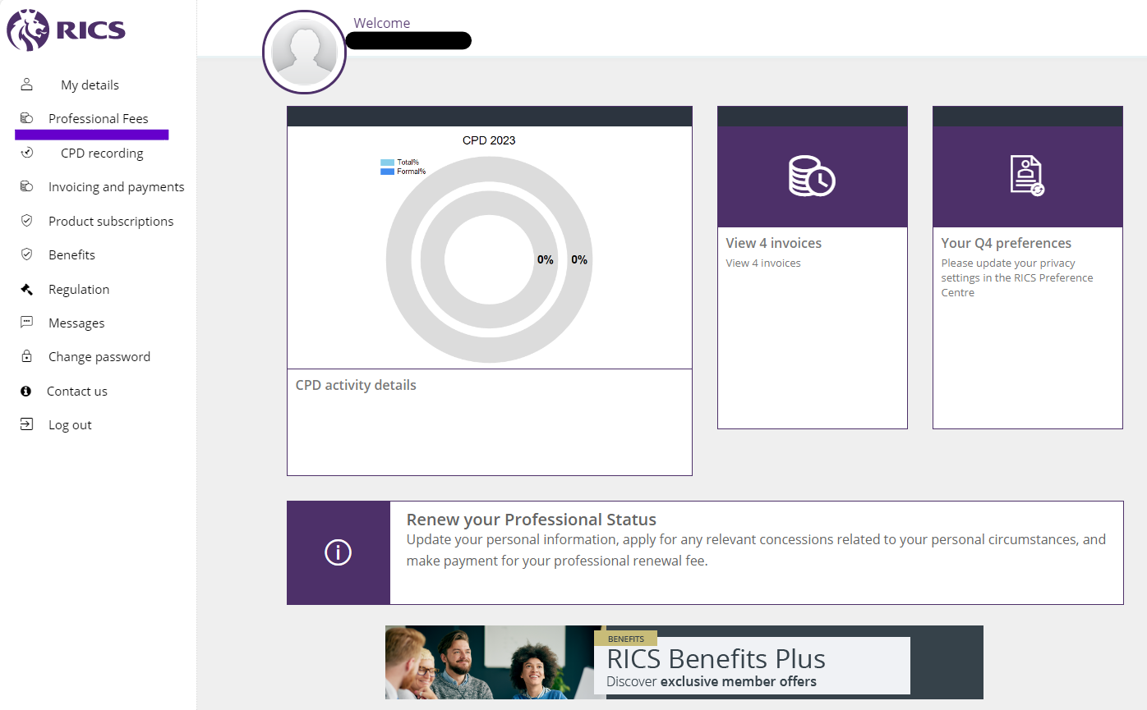
RICS my account
Please select the professional fees tab from the left-hand toolbar as indicated below.

Slide 4
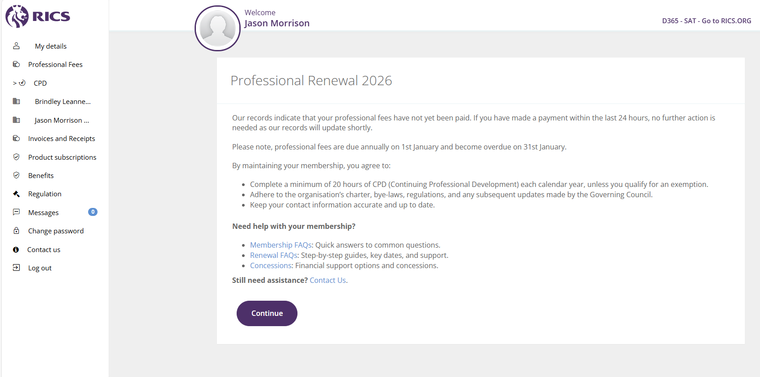
Intro page
This is the opening page for your professional renewal.
If you are ready to proceed to the next page, please press the ‘Continue’’ button.

Slide 5
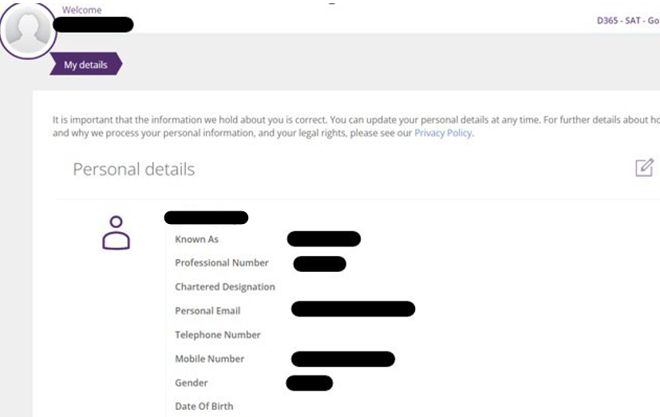

Personal details
On this page you can update any information about yourself that may have changed in the last year e.g. Personal address, new employer, new phone number or email etc by selecting the highlighted edit button.

Slide 6
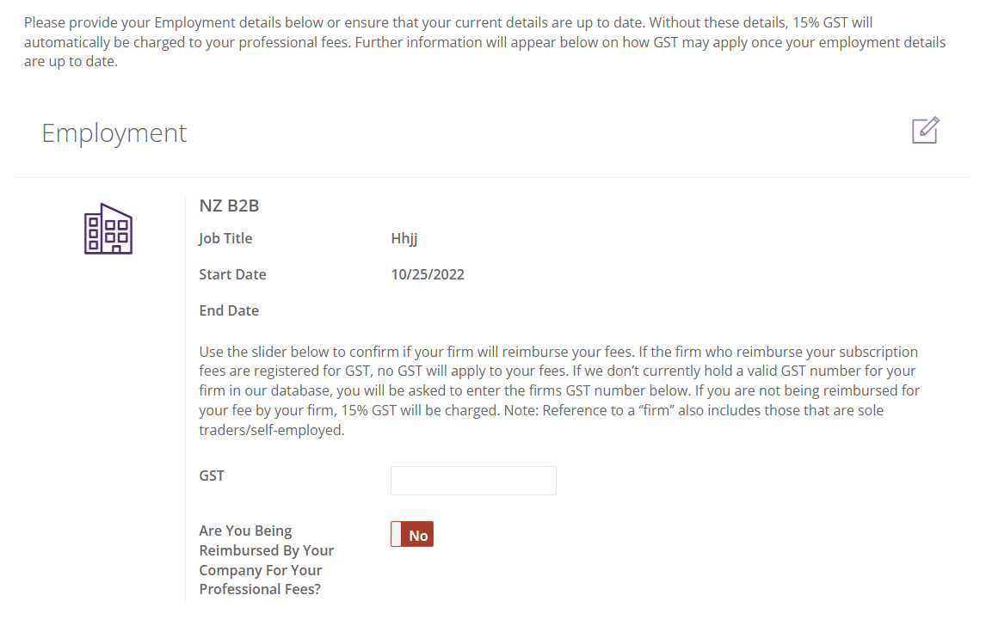
Employment details

Slide 7
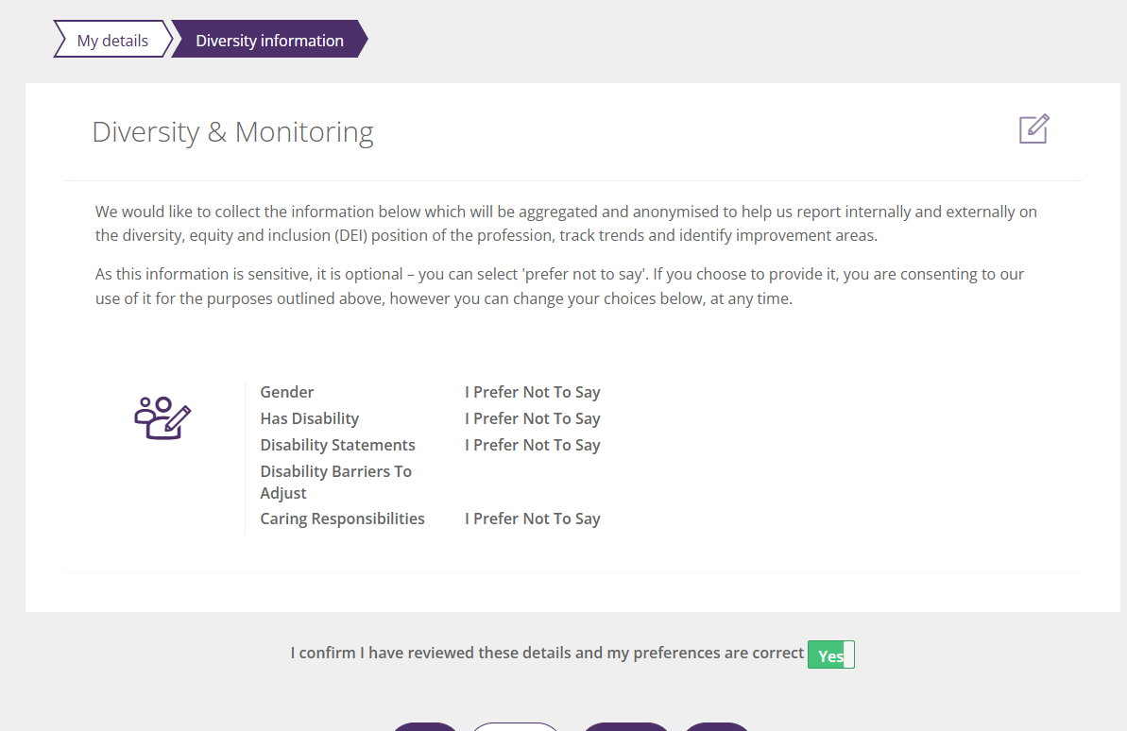
Diversity and Monitoring
On this page, we ask for your DEI information, this helps us with our internal DEI reports. On these, you select which apply to you on the drop down, or alternatively select ‘I Prefer Not To Say’

Slide 8
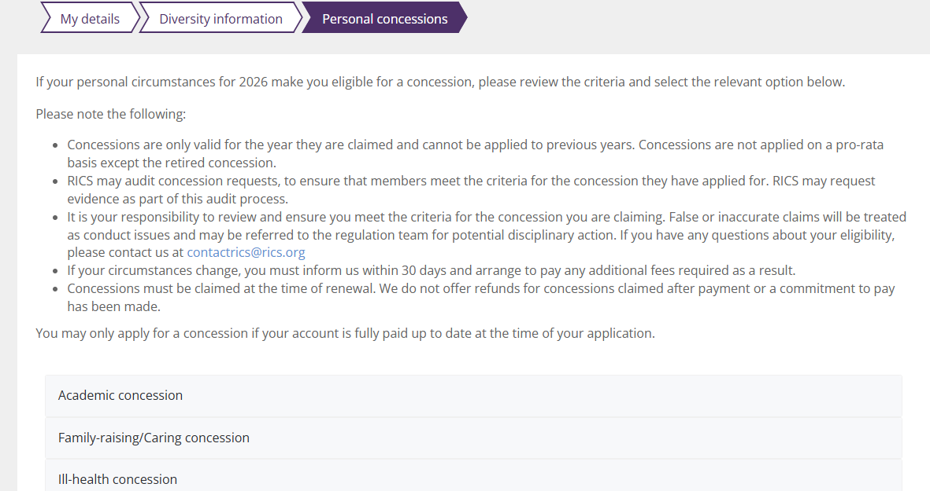
Personal concessions
This is the page in which you can apply for a concession based on your personal circumstances.
Here you can view the general terms and conditions that accompany concessions
You can select any of those listed which will open a list with the terms and conditions etc on them to help you decide if any are applicable.

Slide 9
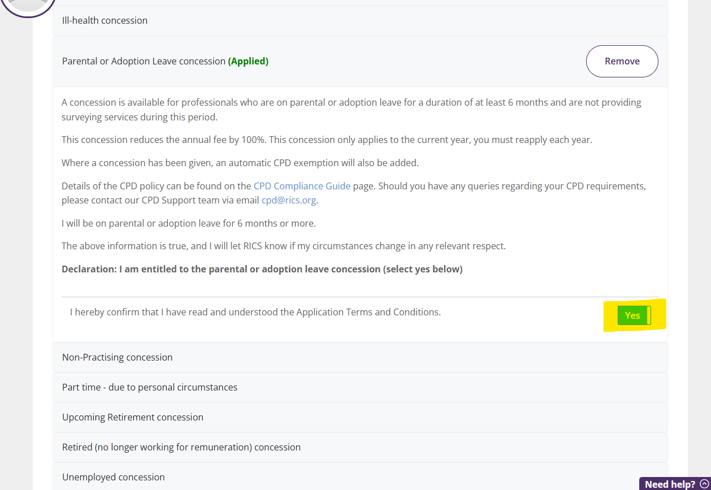
Personal Concessions
If you are eligible for a concession, you can select it by opening it up and pressing the slider button across to confirm you have understood the terms and conditions of that concession.

Slide 10
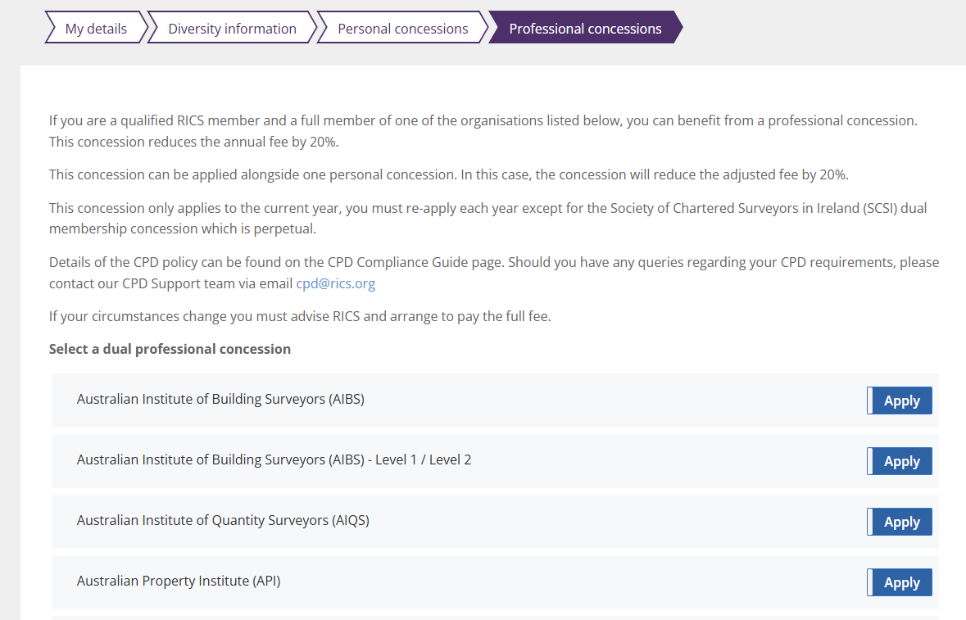
Professional concessions
On this page there is a list of affiliate bodies that you may be a part of, entitling you to a professional concession discount.
To apply, press the Apply button to slide it across and accept.

Slide 11
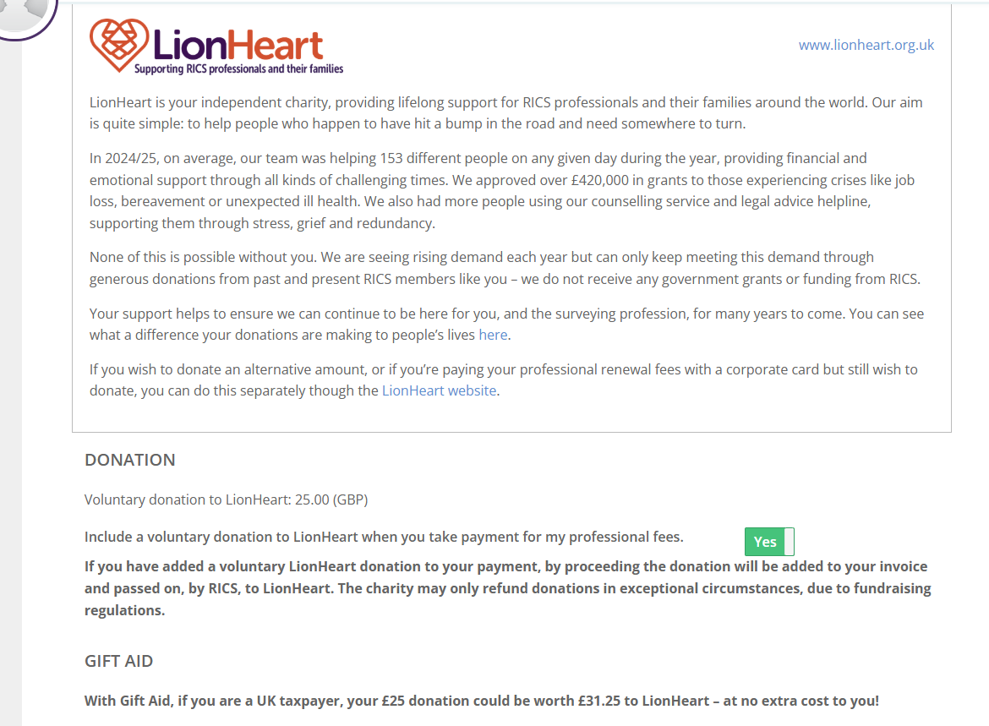
Lionheart
This page gives you the opportunity to learn more about Lionheart and donate if you wish.
Gift Aid is available to UK residents/tax payers only.

Slide 12
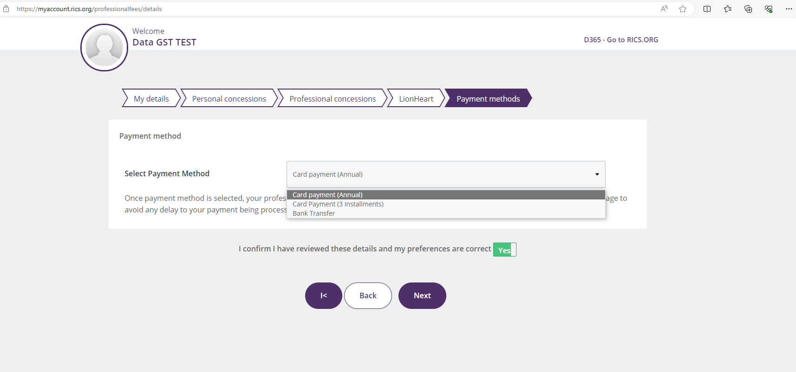
Payment
Please select your payment method from the drop down.
If you select the wrong payment method, you are still able to go back and change it at this point.
Professional fees are not paid locally they are paid to a bank account based in the UK.
Please be aware that you may incur an international bank transfer fee. This fee is charged by your bank and will not be reimbursed by the RICS.

Slide 13
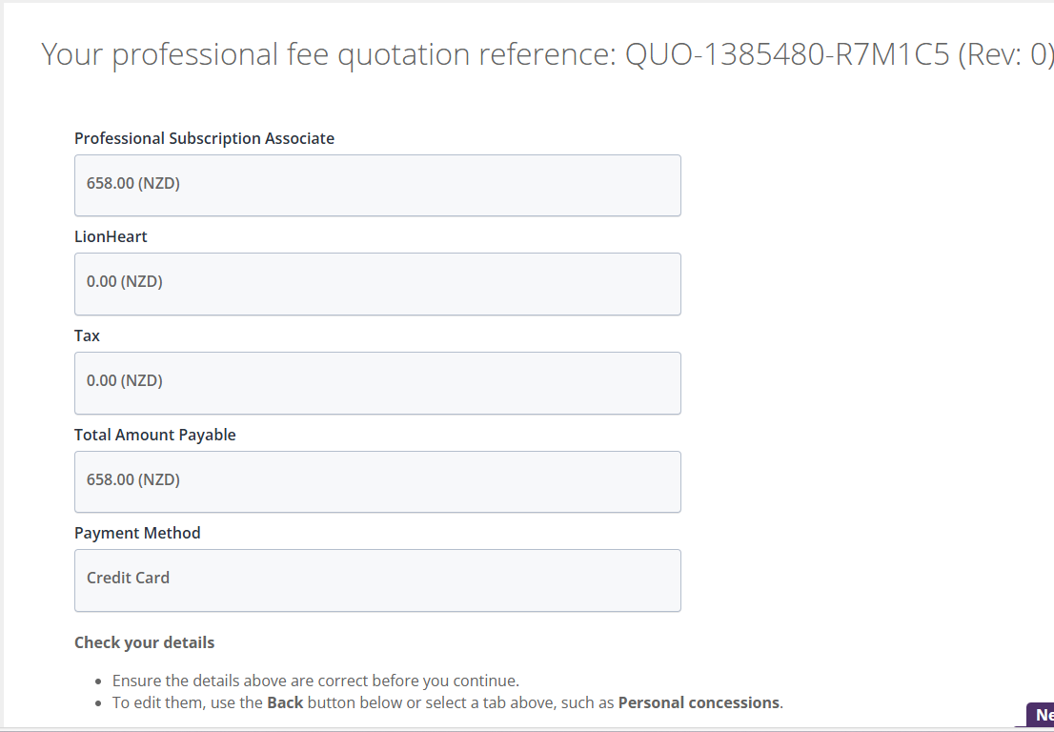
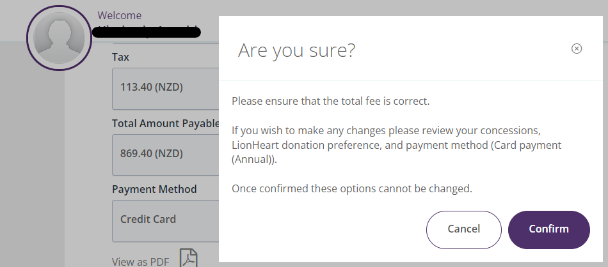
Professional fees quote page – Credit Card
Please review and ensure all quote details are correct.
Please ensure you select the Pay Fee button
Pop-up window will ask you to confirm
You will then be directed to the payment page

Slide 14
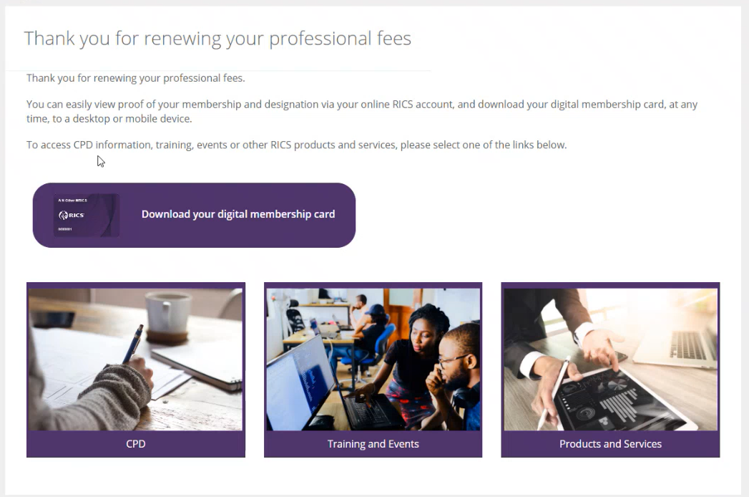
Confirmation page
Once you have made payment, you will be greeted with this screen

Slide 15
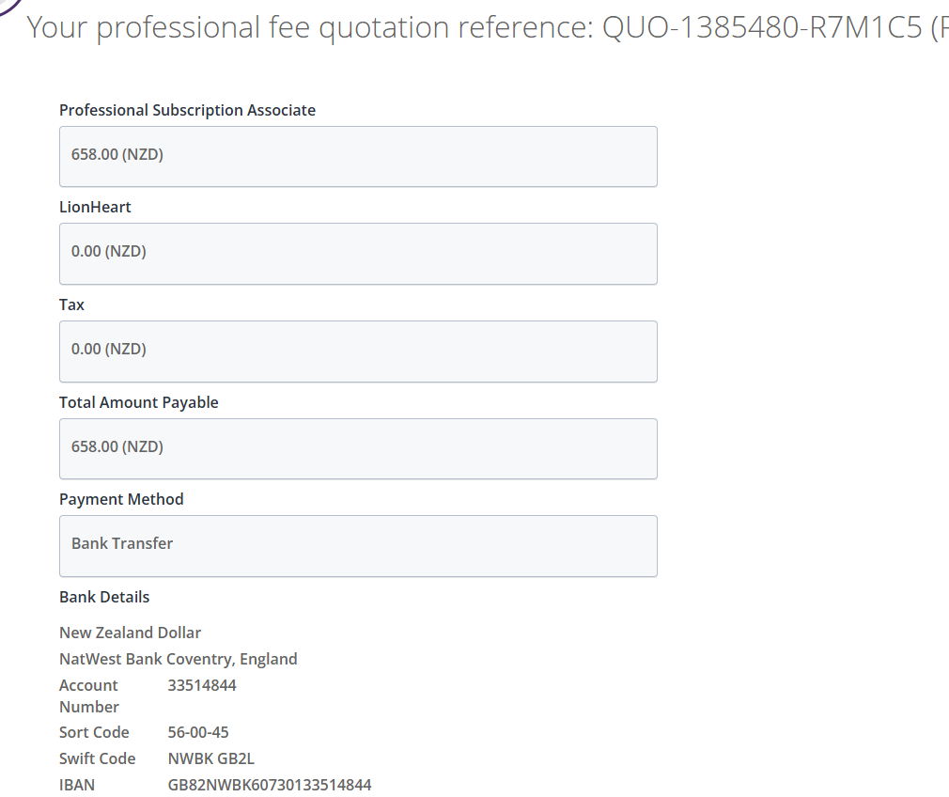
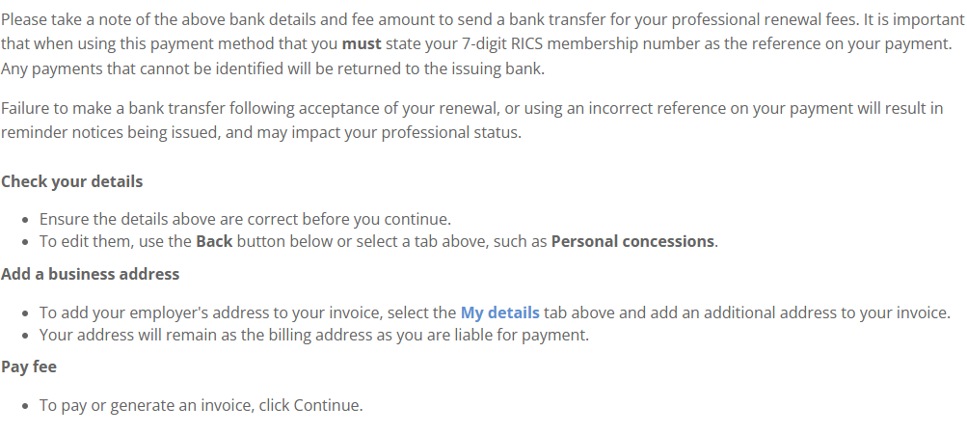
Professional fees quote page – Bank Transfer
Once you confirm this page, you will be unable to add a concession or update your payment preferences.
Please be aware that if you are outside the UK, that professional fees are not paid local, they are paid to a bank account based in the UK you may incur an international bank transfer fee. This fee is charged by your bank and will not be reimbursed by the RICS.

Slide 16
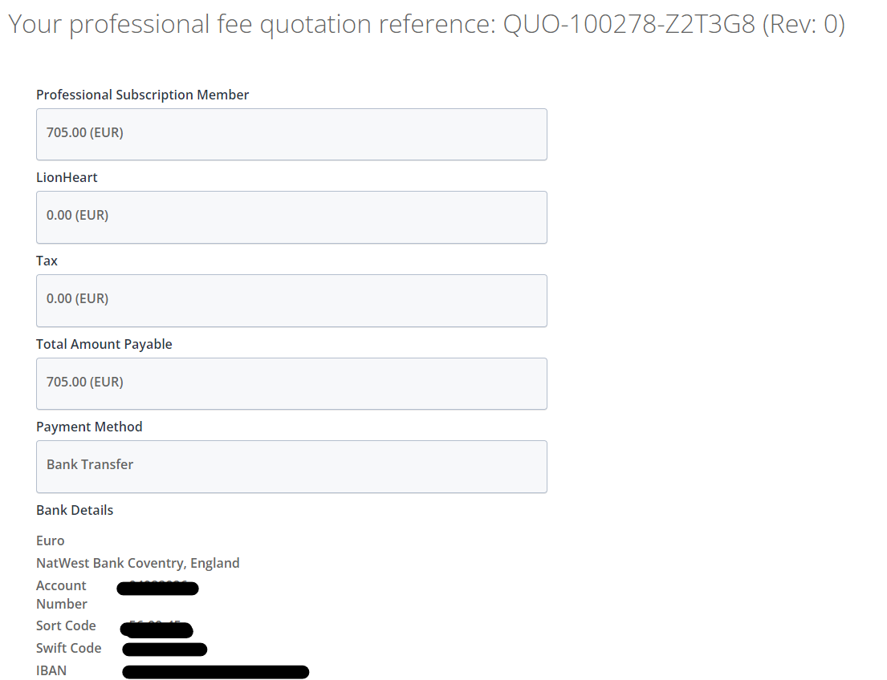
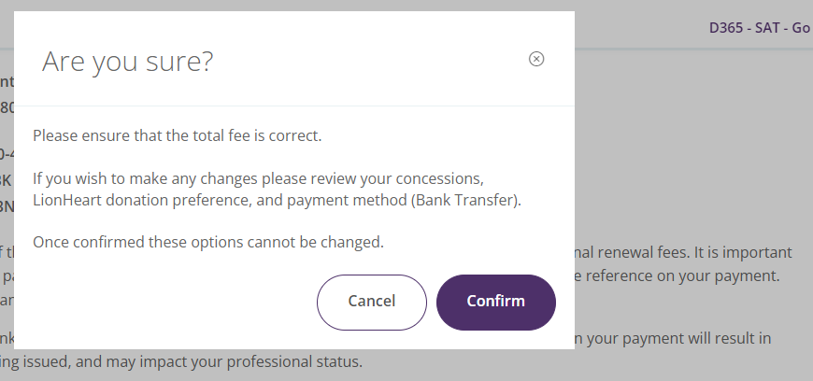
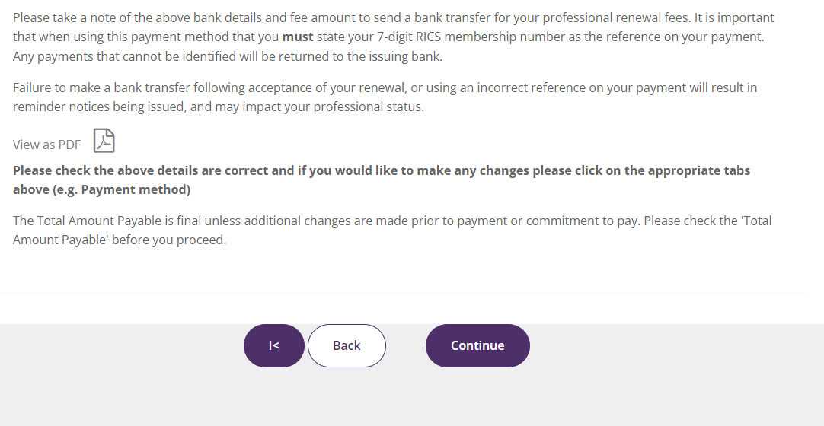
Professional fees quote page – Bank Transfer
Please review and ensure all quote details are correct.
Please ensure you select the Continue button

Slide 17
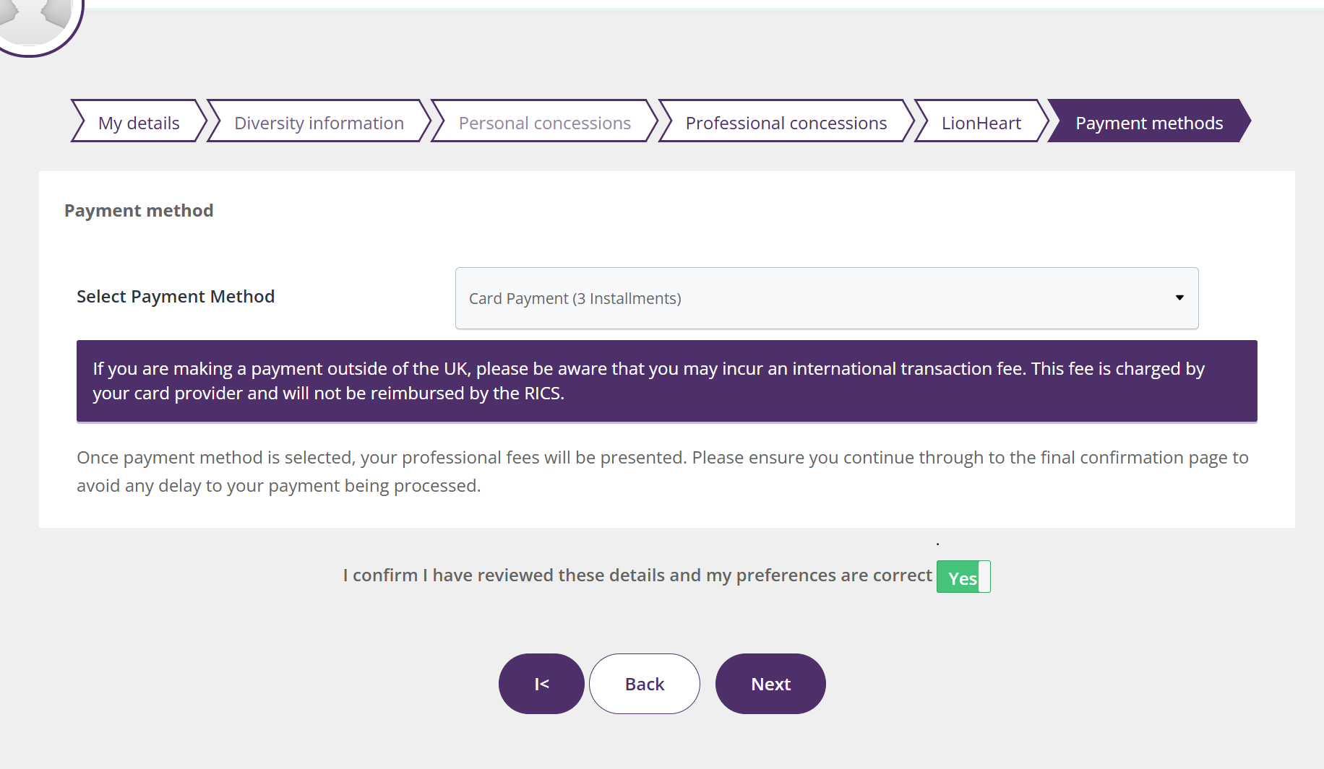
3 Credit Card Instalment
Professionals based within Ireland, America, Europe, Middle East, Africa and most of Asia Pacific can pay their professional fee via three monthly instalments
When selected, the first instalment is taken at the point of set up with two equal instalments over the following 2 months.
Must be set up by 1st March
Not available in UK, China, Korea, Taiwan, Japan, Macao, Hong Kong, India

Slide 18
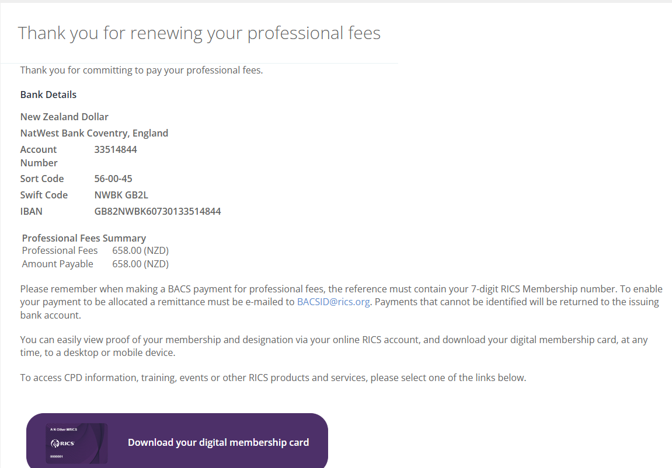
Confirmation page

Slide 19
If you have any questions or need more support, please contact:
Contactrics@rics.org

